Slide 1


Complete Business System for Daily Insights
Your turnkey solution for launching a trending daily insights YouTube channel this weekend.

Slide 2
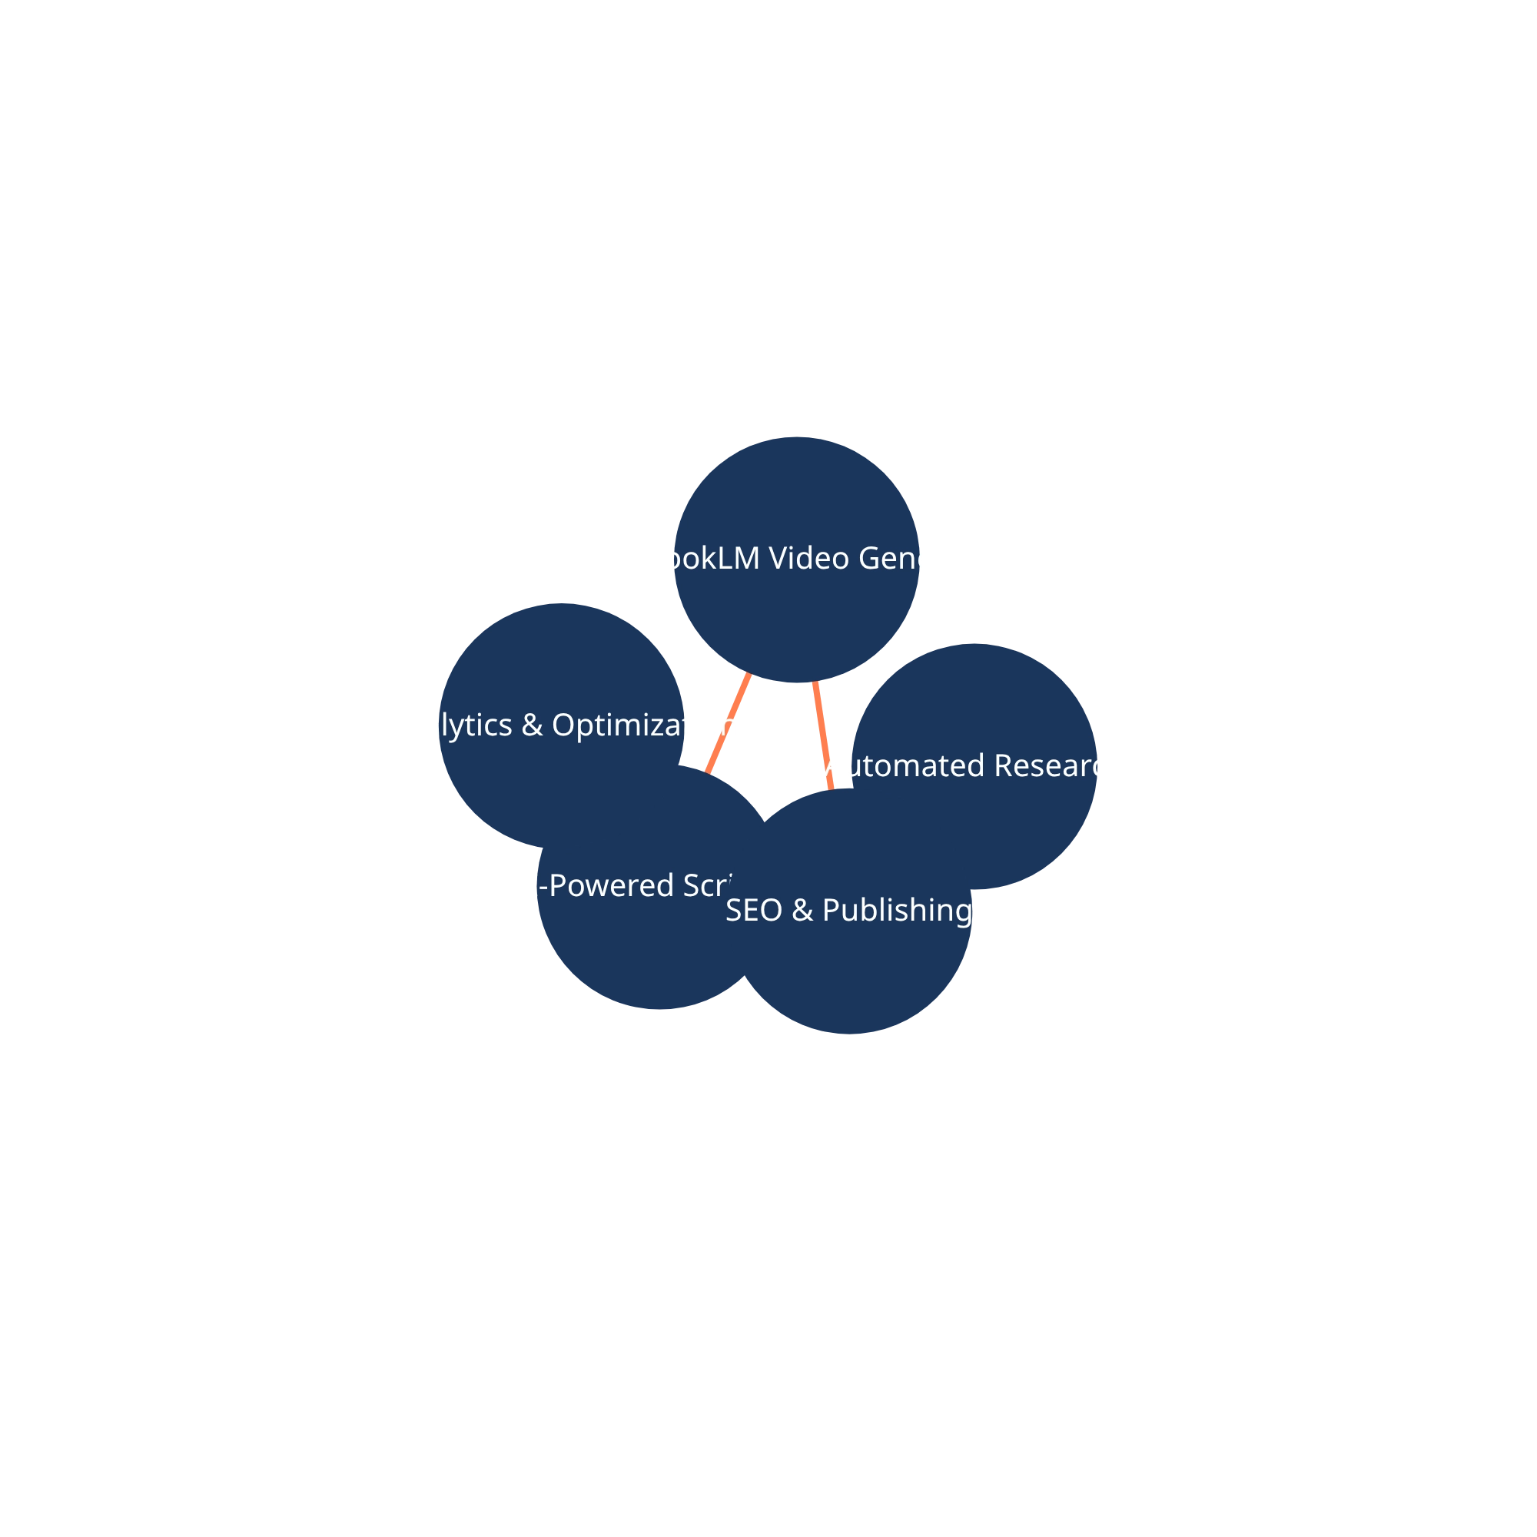
Business Framework & Process Flow
Business Model
The primary revenue stream is ad-supported, leveraging YouTube AdSense. As the channel grows, we will introduce sponsorships, brand deals, and affiliate marketing for diversified income.
Content Workflow
Our daily content pipeline is designed for maximum efficiency and quality. The process is streamlined to allow for a quick turnaround from idea to publication, making a daily upload schedule feasible.
Monetization Strategy
Monetization will be phased in to ensure audience trust and channel integrity. We will start with AdSense, then actively seek out relevant brand partnerships and affiliate opportunities that provide value to our audience.

Slide 3





Automation Tools & Scripts
Streamlined Workflow
A suite of powerful Python scripts automates the entire daily workflow, from initial research to final upload preparation. This system is designed to save you hours of manual work every day.
automation_tools/
research/
Core Components
daily_research_scraper.py
Automatically scrapes trending topics and news from multiple sources.
Research:
content_generation/
notebooklm_processor.py
Converts research into engaging, NotebookLM-optimized video scripts.
Content Generation:
youtube_management/
youtube_uploader.py
Prepares SEO-optimized titles, descriptions, and tags for upload.
YouTube Management:
analytics/
performance_tracker.py
Tracks channel performance and provides actionable insights for growth.
Analytics:
master_workflow.py

Slide 4
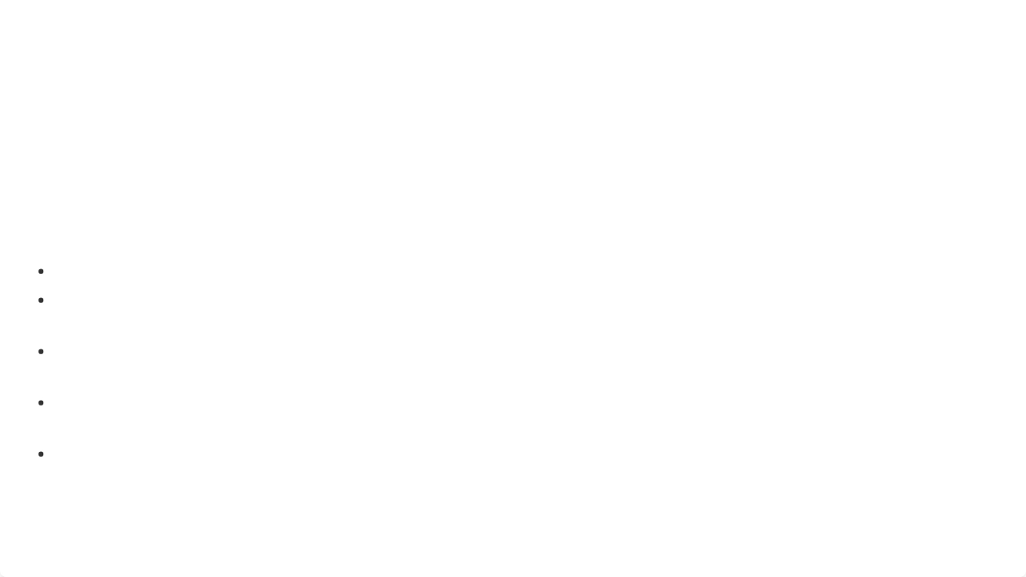
Content Templates & Guides
Jumpstart Your Content Creation
A comprehensive set of templates and guides to ensure brand consistency and high-quality content from day one. These resources are designed to be easy to use, even for beginners.
What's Included
Content Templates:
For structuring your daily insights videos.
General Content Template
Script Template
Optimized for NotebookLM video generation.
Script Templates:
Thumbnail Design Guide
SEO Optimization Guide
Best practices for creating high-CTR thumbnails.
Thumbnail Guides:
To help your videos get discovered by new viewers.
SEO Guides:
Content Calendar:
To plan and track your content schedule.

Slide 5
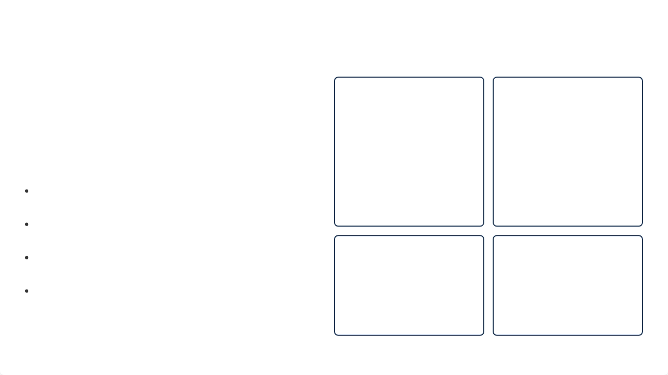




Visual Assets & Branding
A Cohesive & Professional Brand
A complete set of visual assets to ensure your channel has a professional and consistent brand identity from day one. These assets are designed to be modern, authoritative, and visually appealing.
Key Assets
A modern and professional logo that is easily recognizable.
Logo:
Clean and professional graphics for on-screen text.
Lower Thirds:
Eye-catching templates designed for high click-through rates.
Thumbnails:
Professional and non-distracting backgrounds for your videos.
Backgrounds:

Slide 6

Weekend Launch Checklist
Launch Your Channel This Weekend
Saturday: Setup & Preparation
Follow this simple checklist to get your Daily Insights channel up and running in just two days. This step-by-step guide is designed for a quick and efficient launch.
Setup YouTube Channel
Configure Automation Tools
Run First Research Script
Generate First Video Script
Sunday: Content & Launch
Record/Generate First Video
Create Thumbnail
Upload & Schedule First Video
Announce Channel Launch

Slide 7
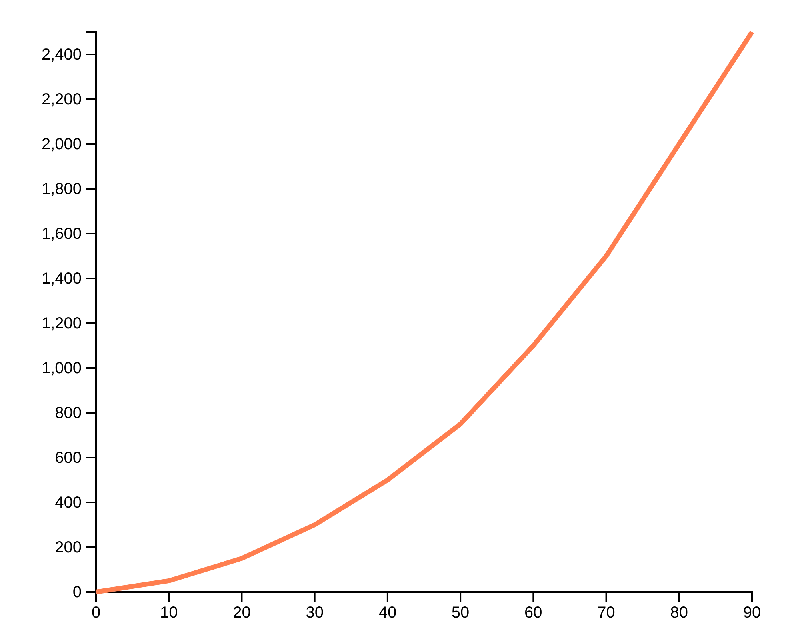
Next Steps & Growth Strategy
Immediate Next Steps
Execute the weekend launch checklist.
Publish your first video and announce the channel.
Engage with your first viewers and build a community.
Monitor analytics to see what's working.
Long-Term Growth Strategy
Consistently publish high-quality daily content.
Collaborate with other creators in your niche.
Expand to other social media platforms.
Explore new monetization opportunities.

